Slide 1
Chimera Creator
By Wolf Pickens

Slide 2

Introduction

Slide 3
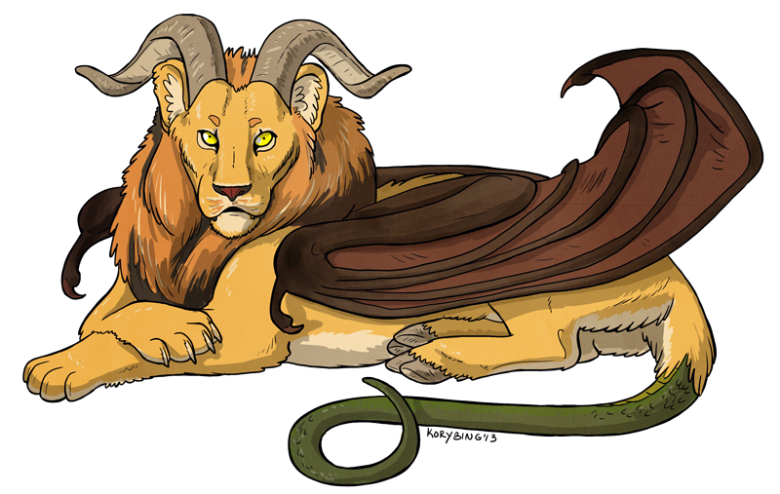
What is the Chimera Creator?
On the back end, the Chimera Creator is a database of animals, their traits, and their component parts
These animals are the building blocks from which “chimera,” or hybrids of multiple animals mixed together, are created

Slide 4
Purpose &
Userbase

Slide 5
What is the purpose of this site?
Using the stored animal data, the site creates brand-new mixtures of animal traits, or new chimeras
This is primarily an exercise in creativity, offering the creation of something new for use in art, writing, or other mediums

Slide 6
What is the userbase?
As the Chimera Creator is primarily a creative endeavor, the intended userbase is artists, writers, game designers, and any other person needing monster designs in their jobs
Anyone and everyone interested in fantasy creatures can make use of it

Slide 7
Website
Demo

Slide 8
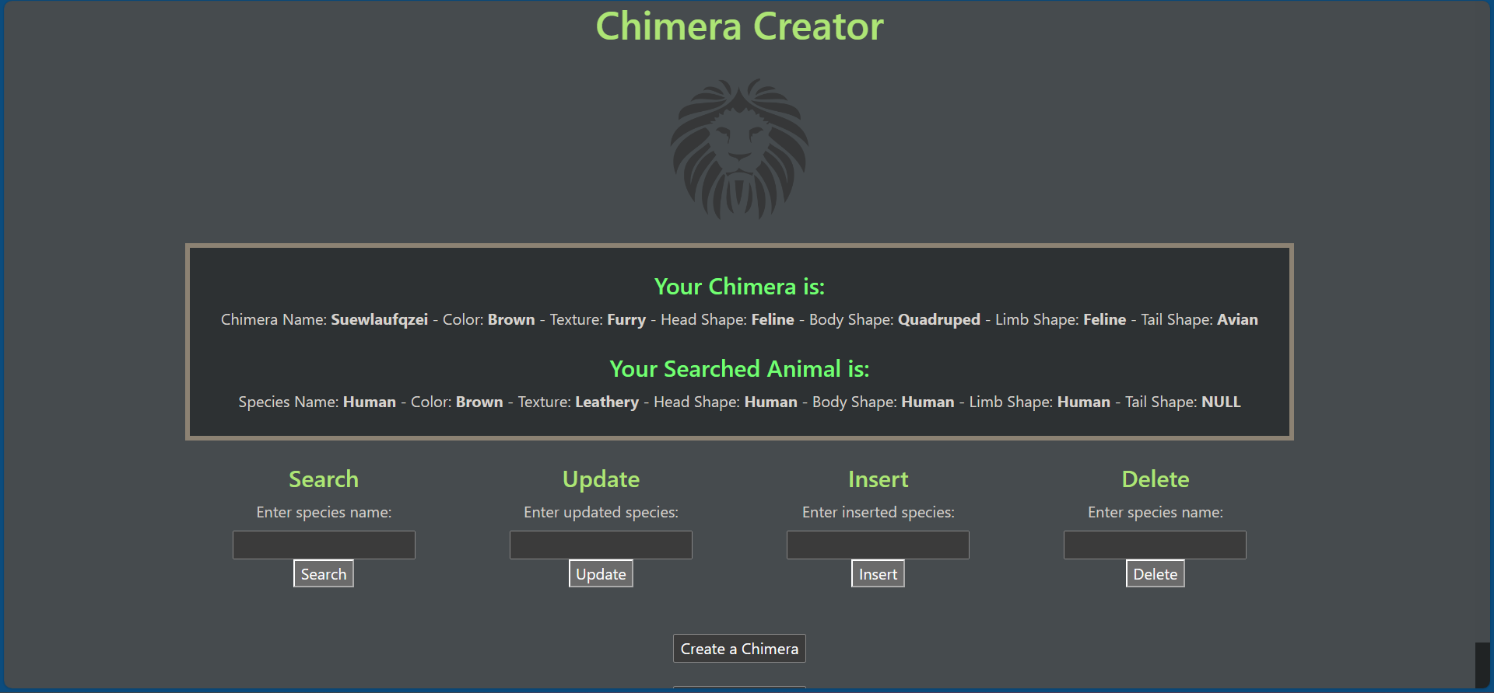
Website Demo

Slide 9
Thank you!

